Slide 1

RDBMS MINI PROJECT
IT TRAINING DATABASE MANAGEMENT SYSTEM
Presented by
Innovative Geeks
Notes:
O Logo de espadas deve ter mais espaço das pontas abaixo. Sugerir outros tipos de imagens/ telefone, fones.

Slide 2
TEAM – 2 TEAM MEMBERS
SHREERAM PIPPALLA - 160743
PARVATHANENI MOHITH - 160703
A BHARGAV SAI - 160550
MADASU DIVYA - 160644
CHUNDURI KRISHNAPRIYA - 160581

Slide 3
TABLE OF CONTENTS
OBJECTIVE
ABSTRACT
SOFTWARE REQUIREMENTS
REQUIREMENTS
FULLFILLING REQUIREMENTS
TABLES USED
UML DIAGRAMS(CLASS,USE CASE)
ER DIAGRAM
TOPICS USED FOR CODING
SOFTWARE ENGINEERING
SQL
PLSQL

Slide 4
TEST CASES
REAL TIME IMPLEMENTATION
ADVANTAGES
PEER TO PEER REVIEW
CONCLUSION AND FUTURE ENHANCEMENT
RESULT
SUMMARY

Slide 5
OBJECTIVE
Designing the database, developing the queries and basic reports required IT TRAINING DATABASE MANAGEMENT SYSTEM.

Slide 6
ABSTRACT OF THE PROJECT
Staff training is an important measure to improve the competitiveness of enterprises, and it is the need of improving staff quality, advancing enterprise sustainable development. To solve the problems that exist in staff training management of traditional enterprise, management information system is developed, database design is an important work for system development, conceptual structure and logical structure are designed based on the architecture of MySQL database management system.

Slide 7
PLANNING PHASE
PLANNING METHODOLOGY :
team-5 project ppt\Mini Project Planning.xlsx

Slide 8
ANALYSIS PHASE
ANALYSIS STEPS :
team-5 project ppt\Mini Project Planning.xlsx

Slide 9
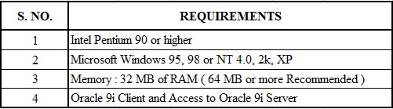
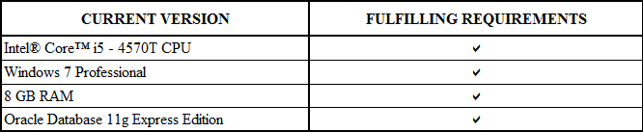
SOFTWARE REQUIREMENTS

Slide 10
DESIGN PHASE

Slide 11
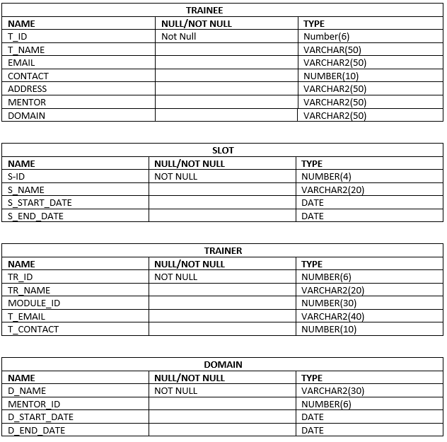
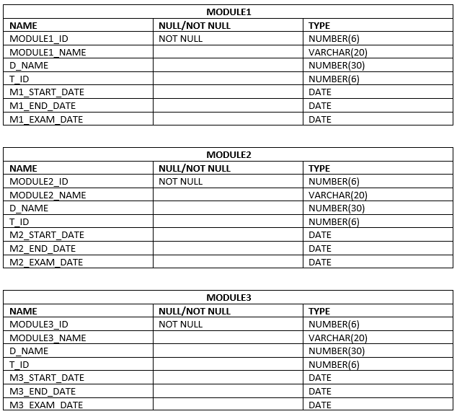
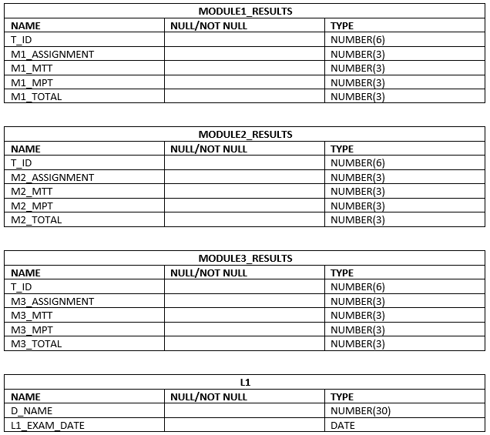
TABLES USED

Slide 12
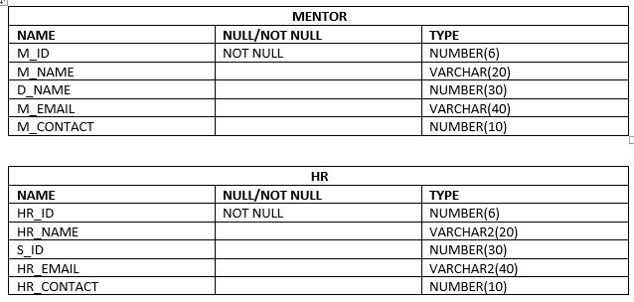
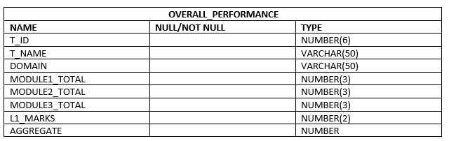

Slide 13
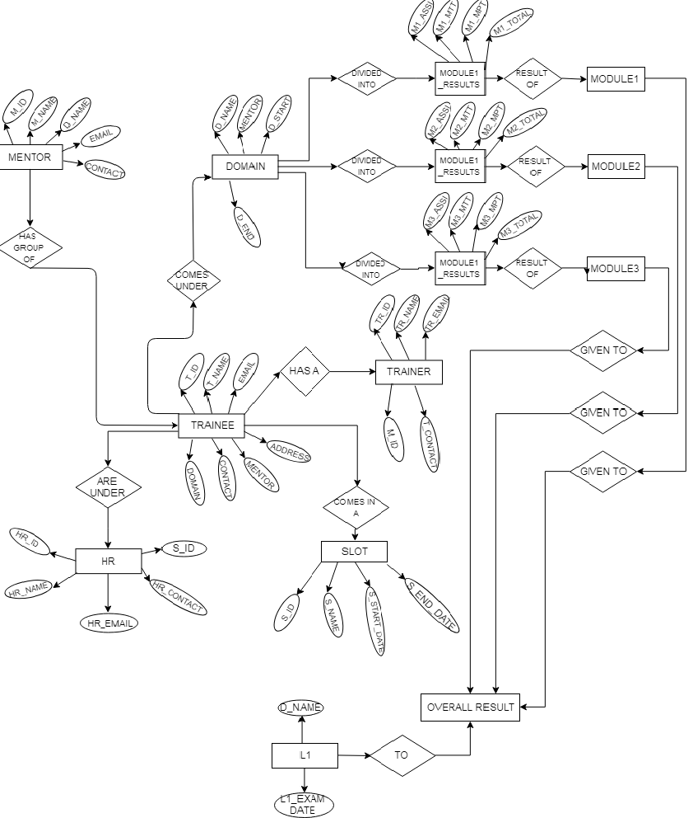
ER DIAGRAM

Slide 14
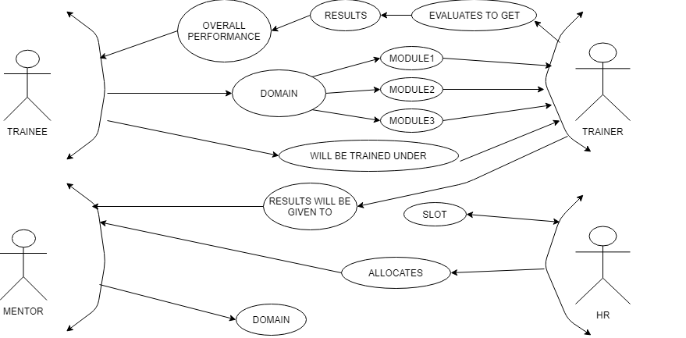
USE CASE DIAGRAM

Slide 15
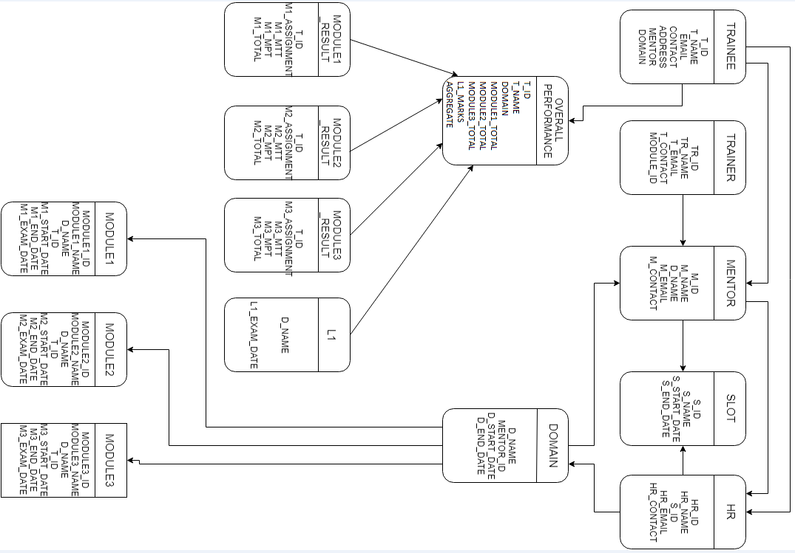
CLASS DIAGRAM

Slide 16
DEVELOPMENT PHASE

Slide 17
TOPICS USED FOR CODING
S. NO. | SUBJECT | TOPIC NAME
1 | SE |  | Data Model like Waterfall Model etc.,
2 | SQL |  | DDL, DML, DCL, TCL, DQL
3 | SQL |  | Joins & Sub Queries
4 | SQL |  | External Tables
5 | PLSQL |  | Procedures & Functions
6 | PLSQL |  | Triggers
7 | PLSQL |  | Exception Handling
8 | PLSQL |  | Cursors

Slide 18
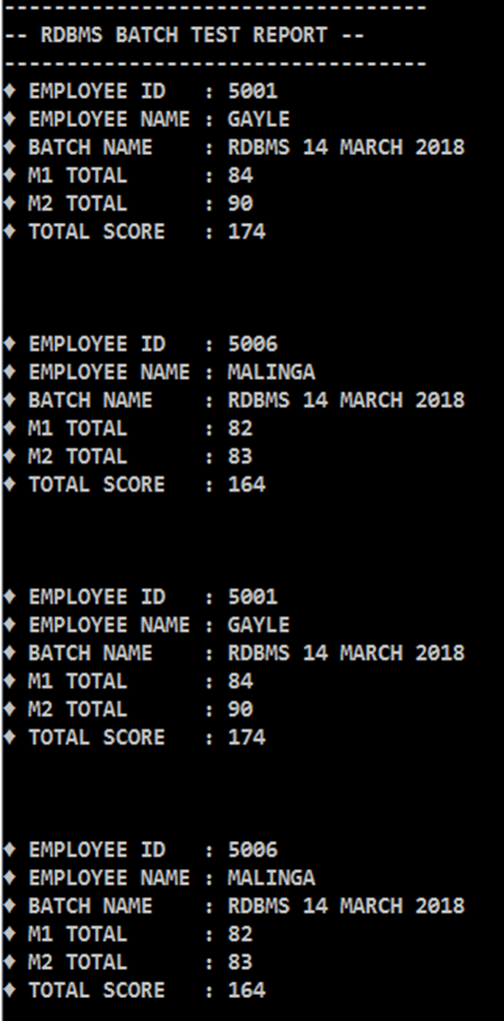
DEVELOPMENT PHASE
CODING:
To perform any functionalities or make applications run we use coding.
The process of designing, writing, testing, debugging / troubleshooting, and maintaining the source code of computer programs.
QUERY SNAPSHOTS:

Slide 19
TESTING PHASE

Slide 20
HOW TESTING IS PERFORMED?
BY EXAMINING THE USERS REQUIREMENTS
BY REVIEWING THE ARTIFACTS LIKE DESIGN DOCUMENTS
BY EXAMINING THE FUNCTIONALITY
BY EXAMINING THE INTERNAL STRUCTURES AND DESIGN
BY EXECUTING CODE

Slide 21
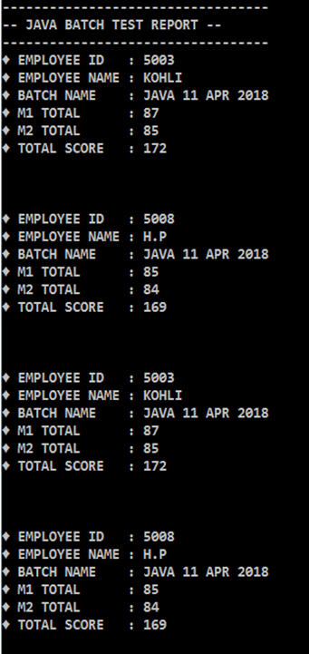
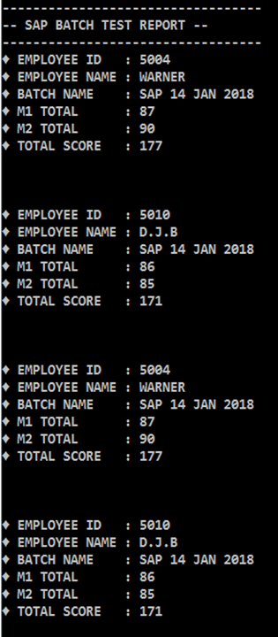
TEST CASES
Example :
Test report for all the employees batch wise.

Slide 22
TESTING SUMMARY
Tested in brief :-
We have tested the functionalities of data present in tables passing various input parameters.
Test Cases :-
Minimum Test cases Performed= 3
Total No. of test cases passed = 2
Total No. of Test cases passed giving exceptions =1
People Worked :-
No. of People worked in this project = 5.

Slide 23
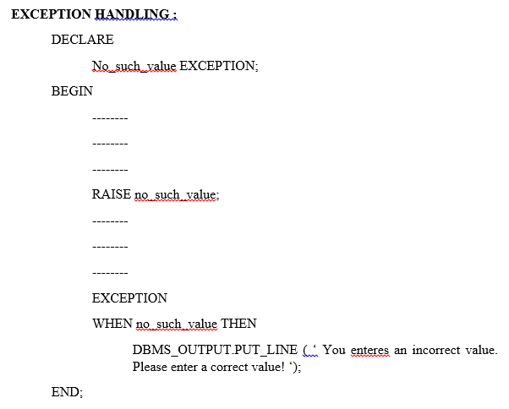
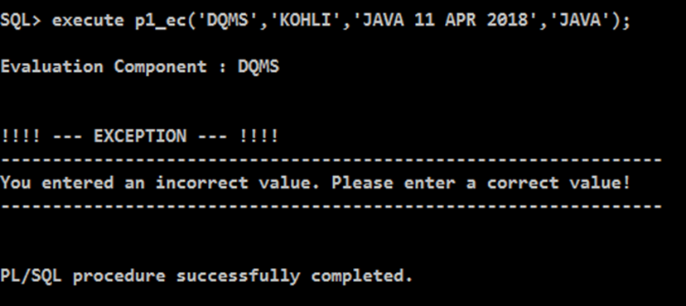
EXCEPTION HANDLING

Slide 24
REAL TIME IMPLEMENTATION
EMPLOYEE PERFORMANCE RECORD
EASY IMPLEMENTATION OF DATA USING PLSQL
ORAGNIZATIONS- EDUCATIONAL SYSTEMS
STORING OF EMPLOYEE PERFORMANCES
EVALUATION SCHEME

Slide 25
ADVANTAGES
REDUCES NETWORK TRAFFIC
ERROR HANDLING
IMPROVES APPLICATION PERFORMANCE

Slide 26
SUMMARY
A DATABASE SYSTEM FOR IT TRAINING DATABASE MANAGEMENT SYSTEM IS BUILD WITH NECESSARY FUNCTIONALITIES.
VARIOUS FUNCTIONALITIES WHICH ARE BUILD USING THIS PROJECT IS :
CREATING TABLES
INSERTING DATA
DISPLAYS TEST MARKS OF AN TRAINEE WITH GIVEN SPECIFICATIONS
GIVES DETAILS OF ALL DOMAIN TRAINEES
PROCEDURES TO ACCEPT DETAILS AND DISPLAY REQUIRED FUNCTIONALITIES
CALCULATES ASSESMENT DETAILS
TRIGGERS TO CHECK THE REQUIREMENTS
CREATING DATA REPORTS

Slide 27
IMPORTANT LINKS
team-5 project ppt\Mini Project Planning.xlsx
team-5 project ppt\miniproject_scriptfile main.txt
team-5 project ppt\Queries.docx

Slide 28
THANK YOU

